Slide 1
Azure API Management Service
Alex Bauer

Slide 2





Azure API Management
http://www.mycompany.com/api/services?type=support&contractlength=short&availablecontractor=bob+smith
http://www.mycompany.com/api/services/support/short/bob+smith
Source: https://communities.bmc.com/welcome
Source: http://trulyitisha.blogspot.com/
Notes:
Microsoft acquired Apiphany in October 2013, an API Management company.
Preview released around May, 2014. Released into General Availability in September 2014.
API Management service that acts as a proxy to your RESTful back-end service. It also offers various features that can be implemented before routing data to the service.

Slide 3
URL transformation
How do we make sense of this mess?

Slide 4
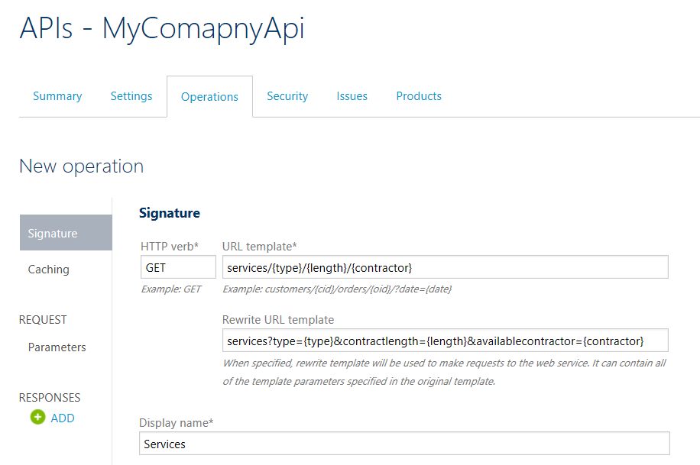
URL transformation

Slide 5
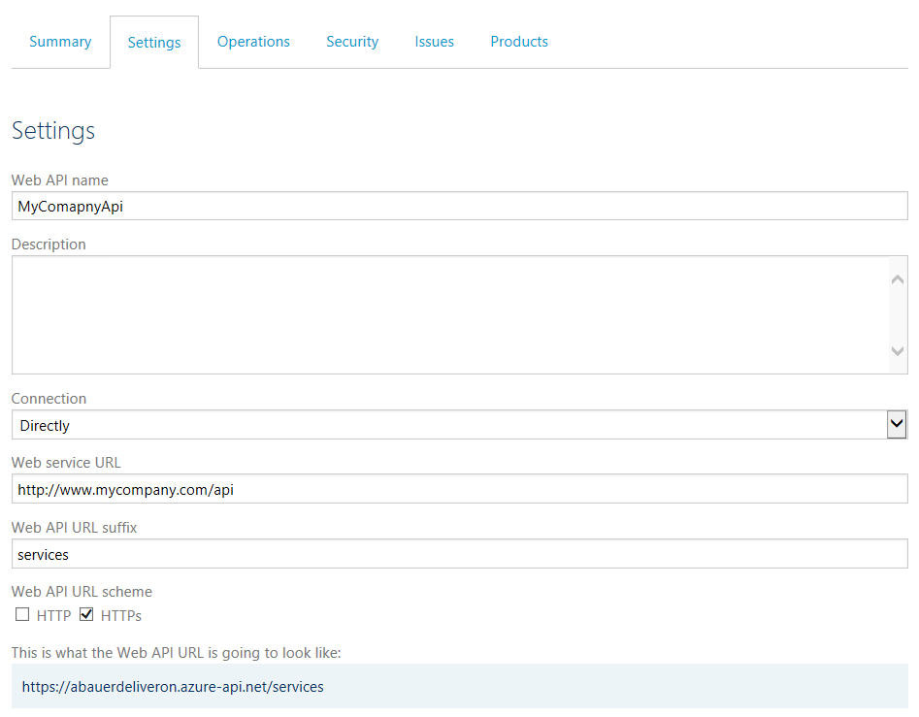
URL Transformation

Slide 6
Documentation
How do we make documentation easy?

Slide 7
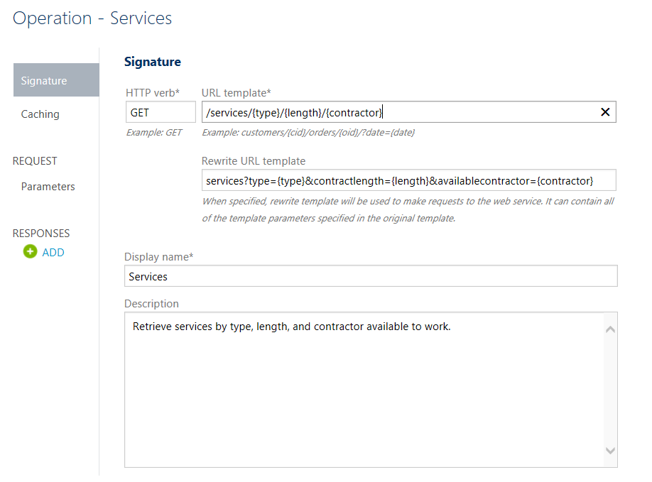
Documentation

Slide 8
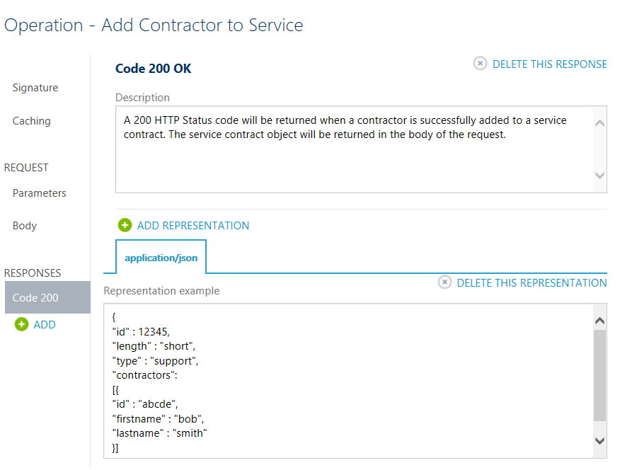
Documentation

Slide 9
Organization
How can I avoid long lists of APIs?

Slide 10
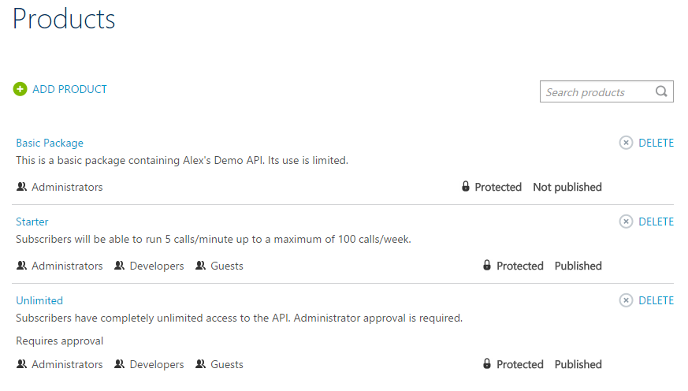
Organization

Slide 11
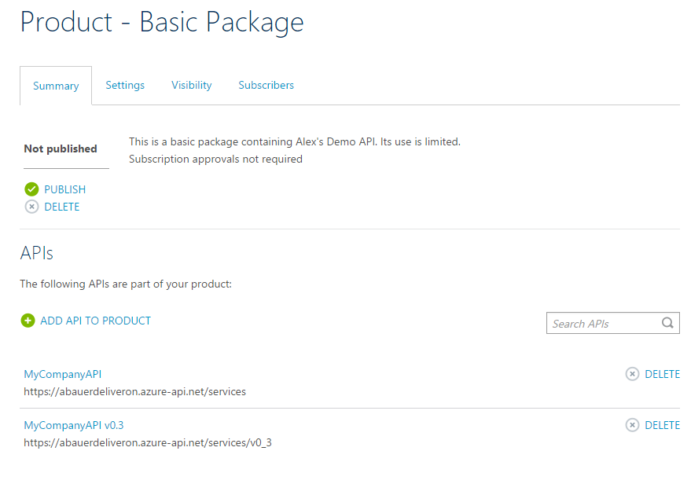
Organization

Slide 12
Control and Monitoring
What if my APIs are unexpectedly popular?

Slide 13
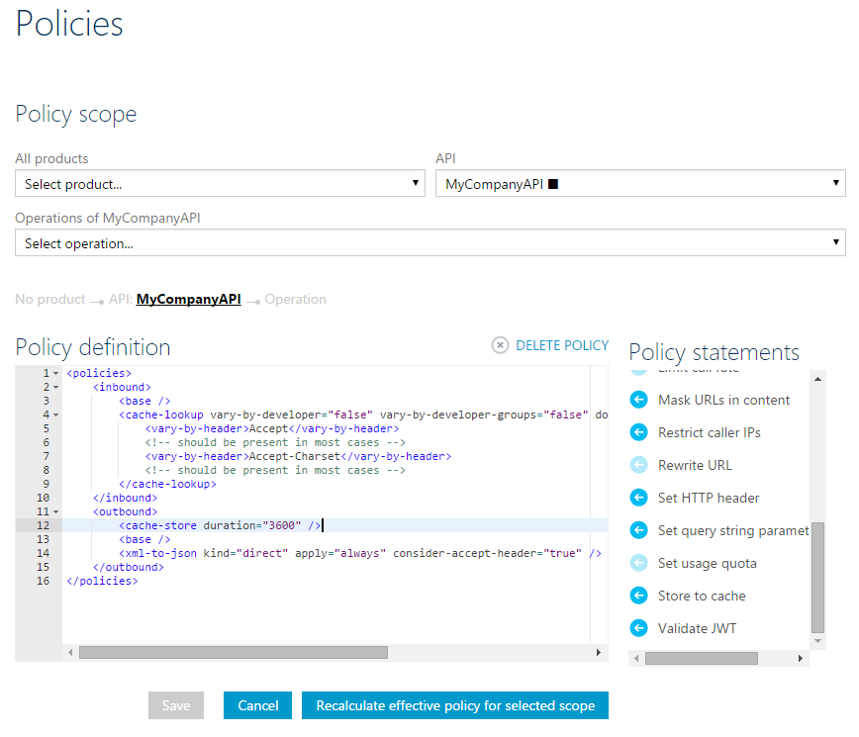
Control and Monitoring

Slide 14
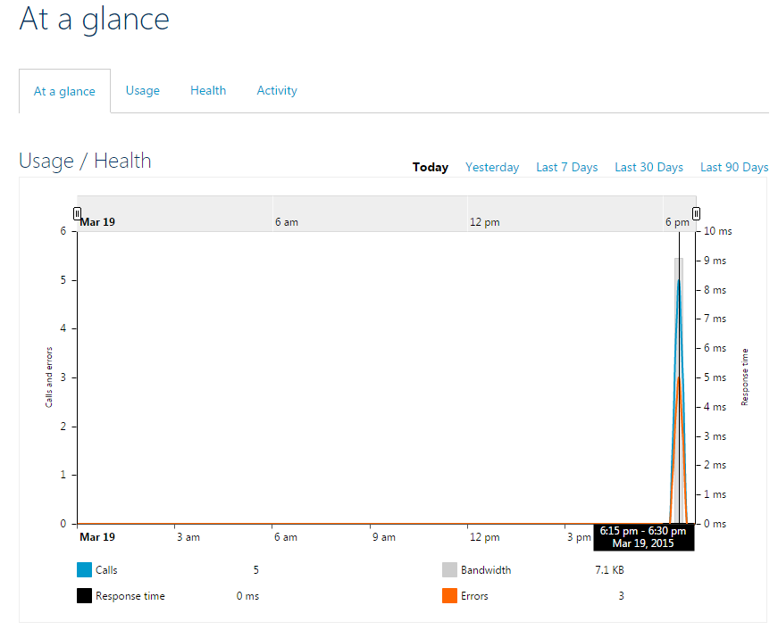
Control and Monitoring

Slide 15
Management
This functionality is great! But how do I manage it?

Slide 16
Security and Access
How can I secure my API?

Slide 17


Security and Access
Certificates
Basic, OAuth, etc.

Slide 18
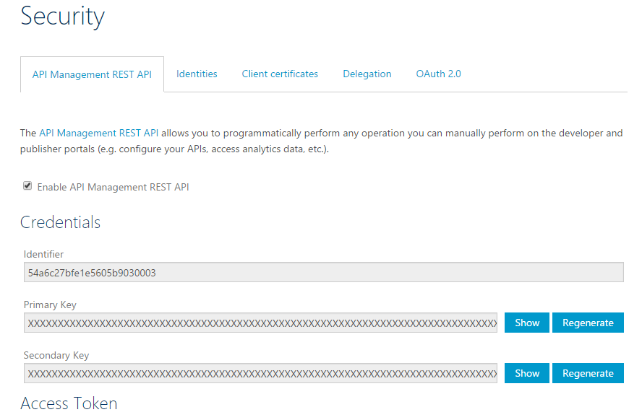
Security and Access

Slide 19
Limitations
This sounds great! What’s wrong with it?

Slide 20
Limitations
Full Dev Portal Customization
HTTP Compression
PowerShell

Slide 21
Automation
If there’s no PowerShell support, how can I automate the process?

Slide 22
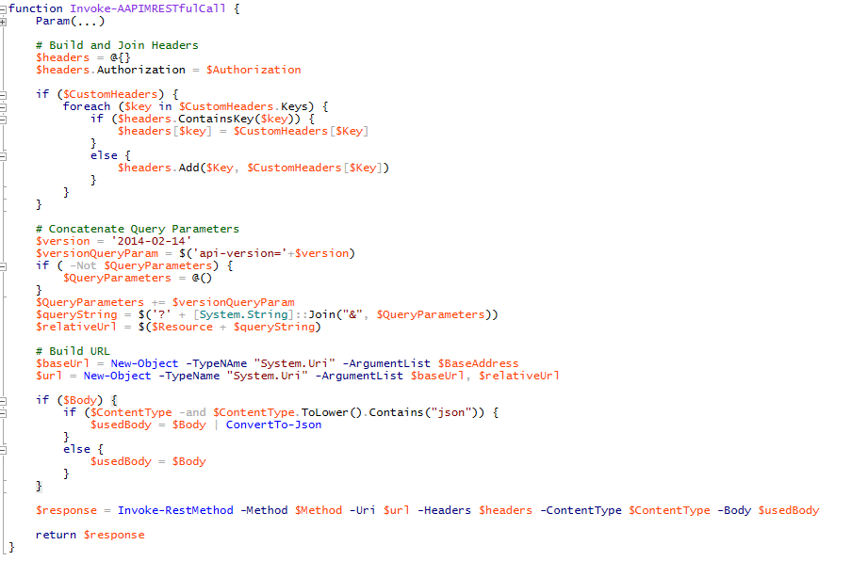
Automation

Slide 23
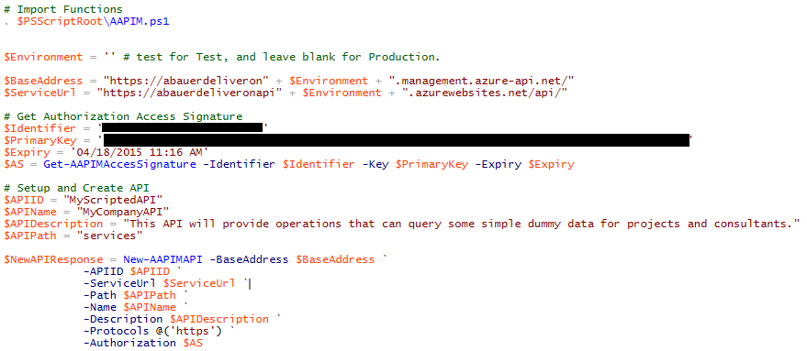
Automation

Slide 24

Automation
http://.../api/swagger
Import from URL

Slide 25
Thank you
Any questions?

